Slide 1
Welcome to Hephzibah high school 2022-2023
Ms. Bridgett Hill
Math Teacher
hillbr@boe.Richmond.k12.ga.us
706-592-2089
Notes:
NOTE:
To change the image on this slide, select the picture and delete it. Then click the Pictures icon in the placeholder to insert your own image.

Slide 2
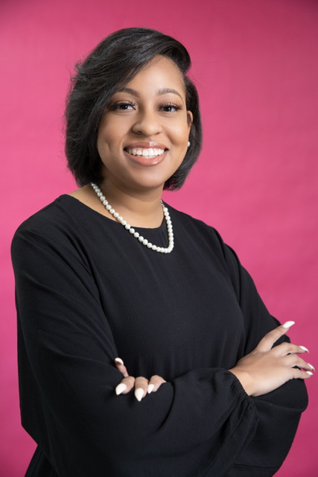
About Me
Biography: Hello! I am Ms. Hill and this is my first year teaching at Hephzibah High School. I worked in higher education for 10 years before transitioning to Hephzibah High School. I am committed to educating students through curriculum and instruction, all while promoting fun and excitement in the classroom.
Education: Bachelors of Arts: Psychology & Masters of Education
Hobbies: Spending time with my family and friends, reading, writing, and binge watching TV shows
Content Areas: Algebra I and Geometry

Slide 3
About You
Name
Name you go by
Something interesting about you
Hobbies

Slide 4
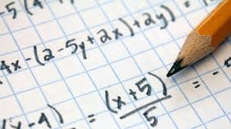
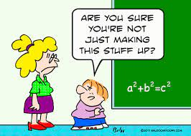
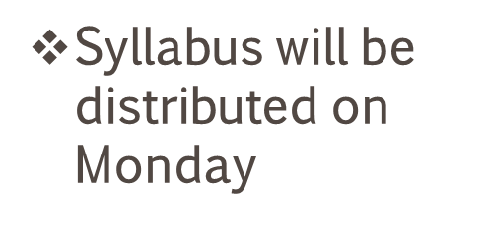
Courses
Algebra I

Slide 5
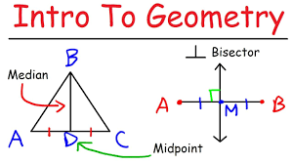
Courses
Geometry

Slide 6
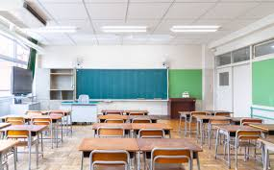
Classroom Rules & Expectations
Be respectable to staff and students
Be prepared for class each day
Follow directions
Submit all assignments on time
No cheating or plagiarizing
Remain positive
Be attentive during class
No use of cell phones during instruction (unless instructed otherwise)
No food or drinks during instruction
Raise your hand if you have a question or need anything (pencil sharpener, ect)
Cannot leave room unless it is an emergency (School rules)
I dismiss class. NOT the bell

Slide 7
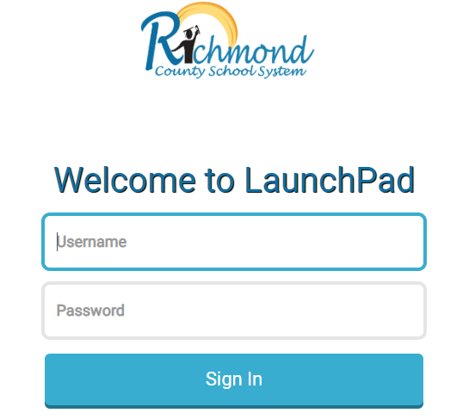
Canvas
https://www.rcboe.org/canvas
https://launchpad.classlink.com/rcboe
What are my username and password?
USERNAME: YOUR RICHMOND COUNTY EMAIL ADDRESS
EX: king.martinl@student.rck12.net
PASSWORD: THE SAME AS YOUR RICHMOND COUNTY PASSWORD
https://rcboe.instructure.com/courses/29682/pages/navigation-overview?module_item_id=50136

Slide 8
Remind App
Remind is a communication platform that helps every student succeed. Whether it is in the classroom, at home, or anywhere in between, Remind makes it easy to stay connected to the school community. + Send real-time messages to any device. + Message a class, a person, or just a small group.
HHS Algebra I @HillAlgeb
HHS Geometry @HillGeome

Slide 9
Question & Answer Time

Slide 10
Contact Information
Ms. Bridgett Hill
Phone Number: 706-592-2089
Email: hillbr@boe.Richmond.k12.ga.us
Tutor Hours: By appointment only (Virtual and Physical)

